Slide 1
Erica Barone Technical Evangelist – Windows & IoT @_ericabarone erica.barone@microsoft.com

Slide 2
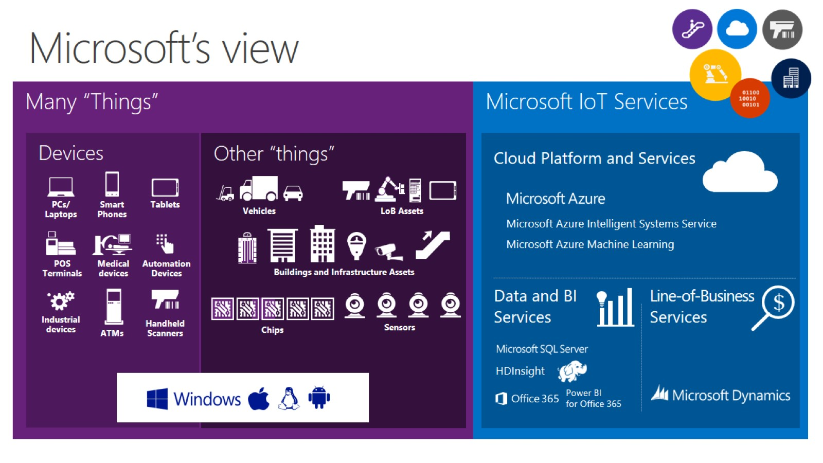

Slide 3
The need for real-time processing

Slide 4
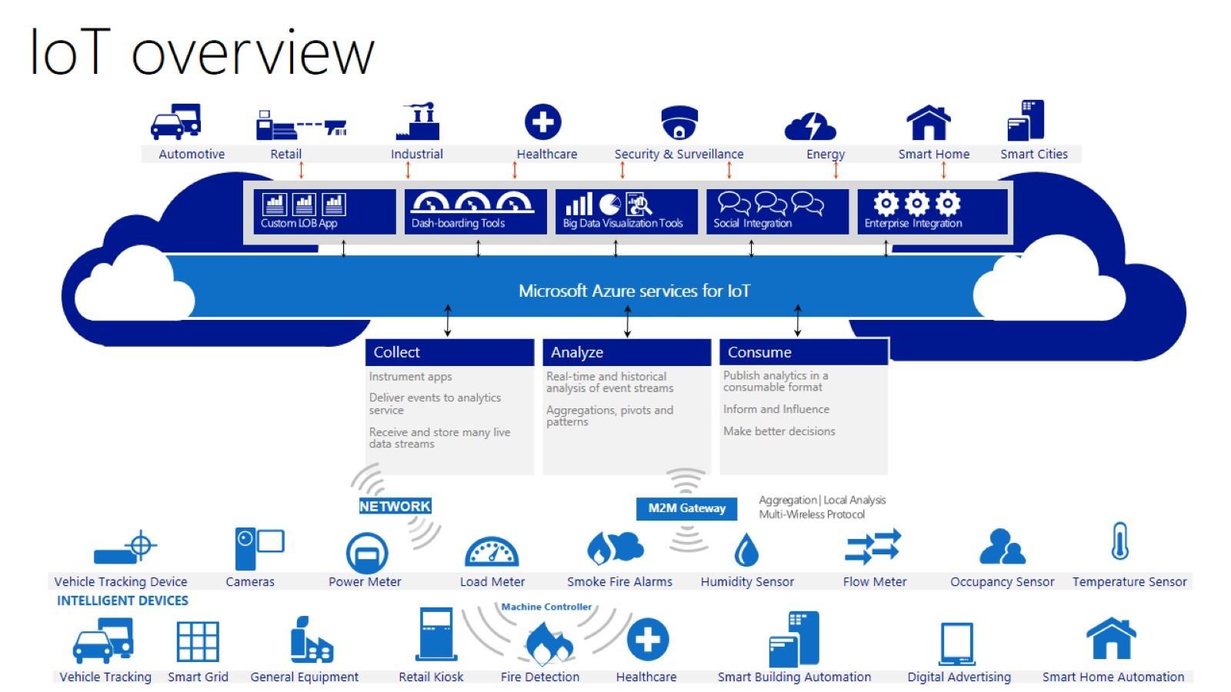
IoT overview

Slide 5
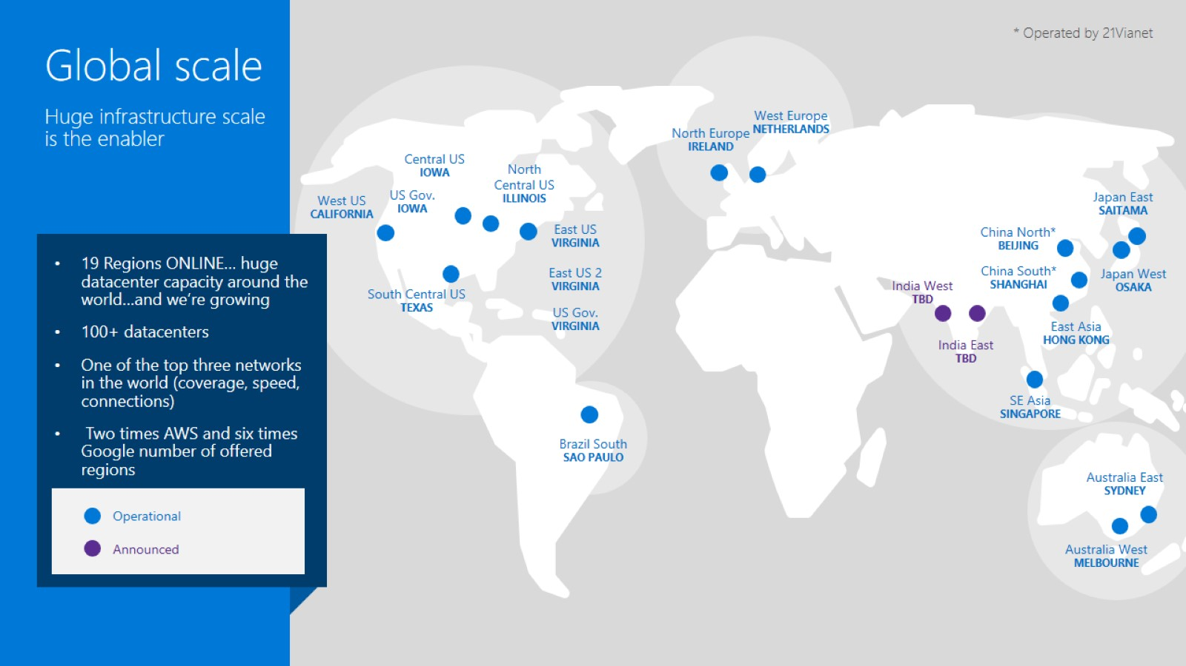

Slide 7
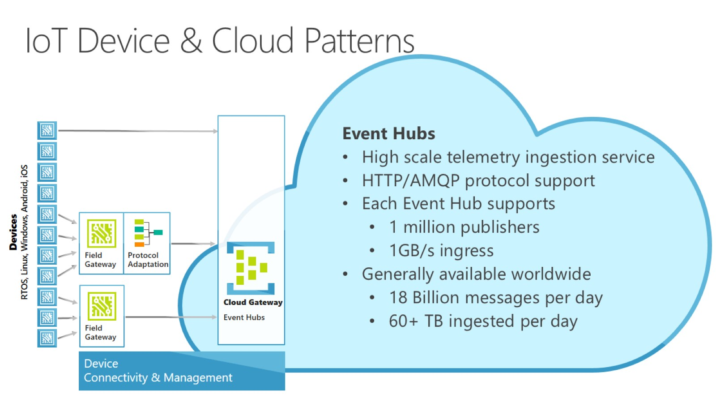
IoT Device & Cloud Patterns

Slide 8
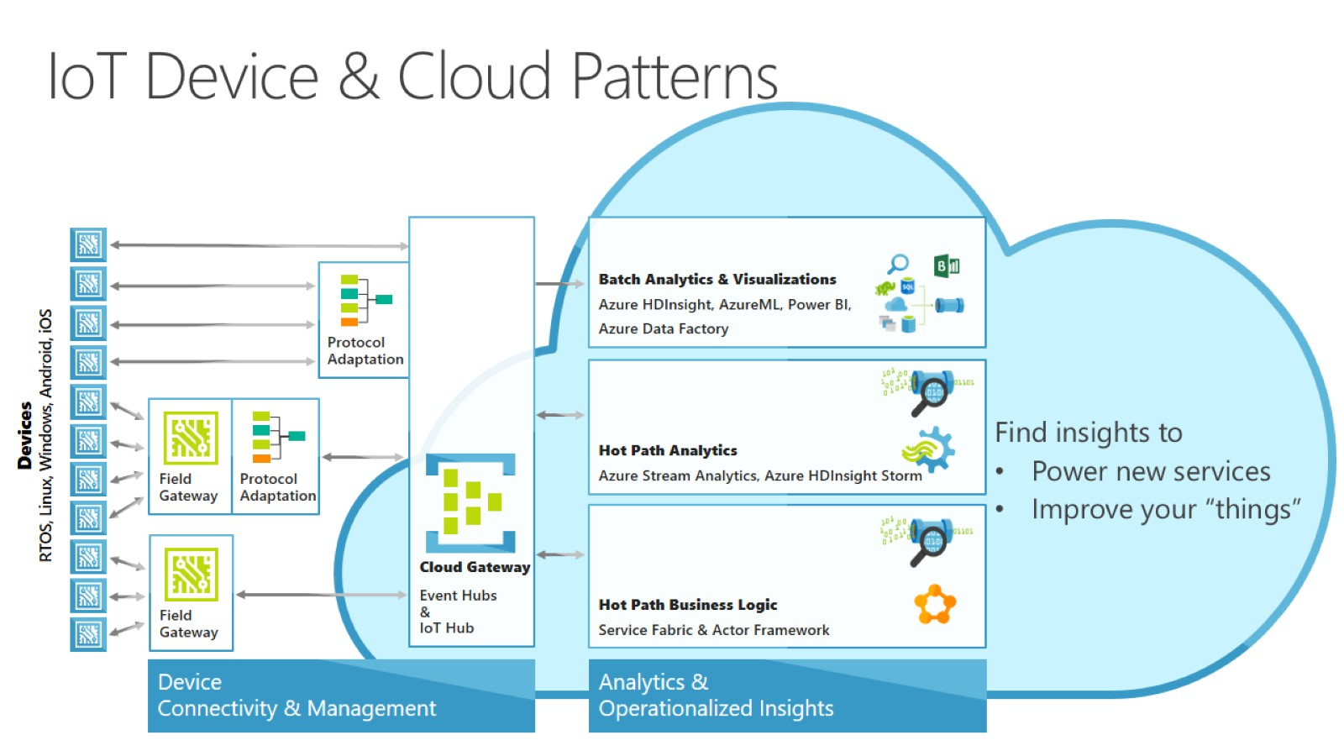
IoT Device & Cloud Patterns

Slide 9
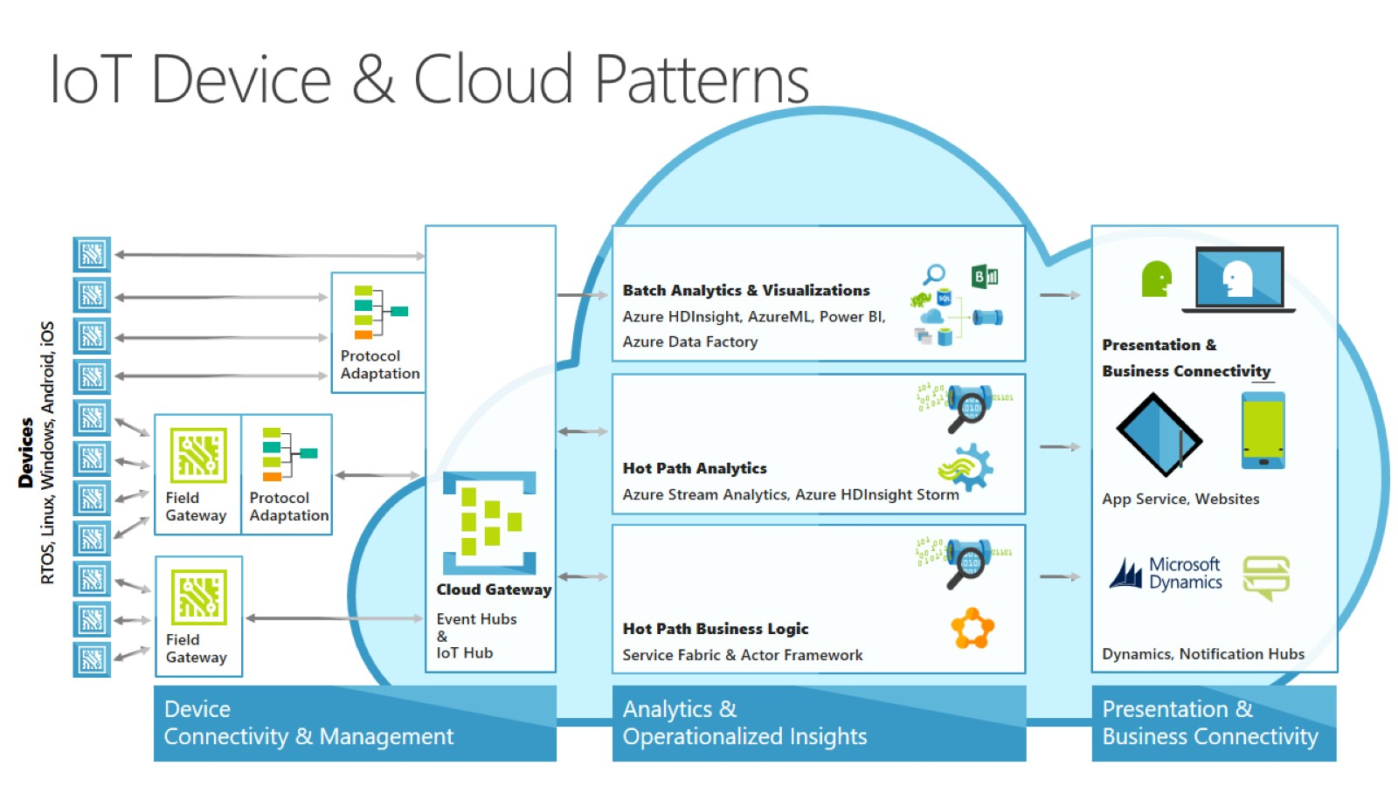
IoT Device & Cloud Patterns

Slide 10
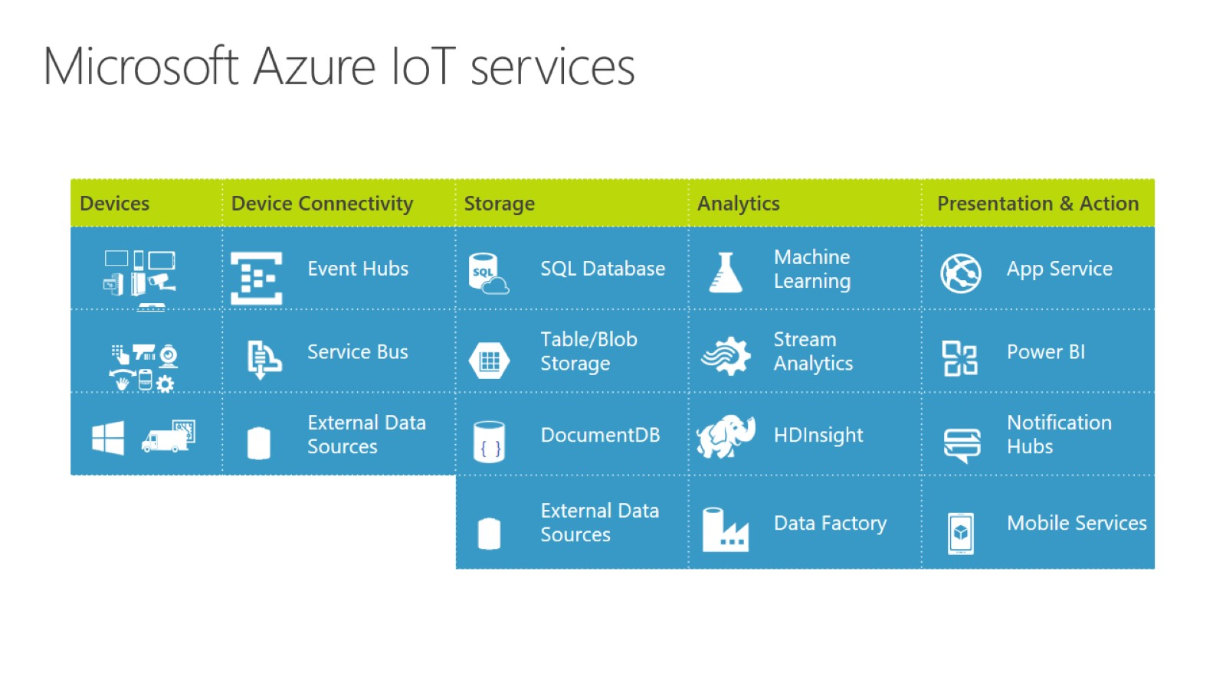
Microsoft Azure IoT services

Slide 11
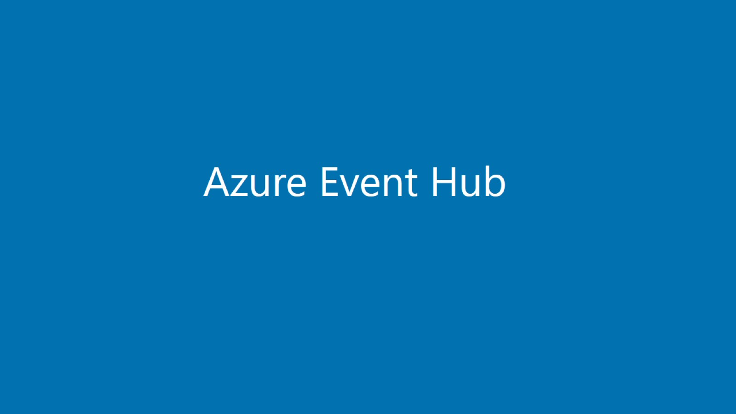

Slide 13
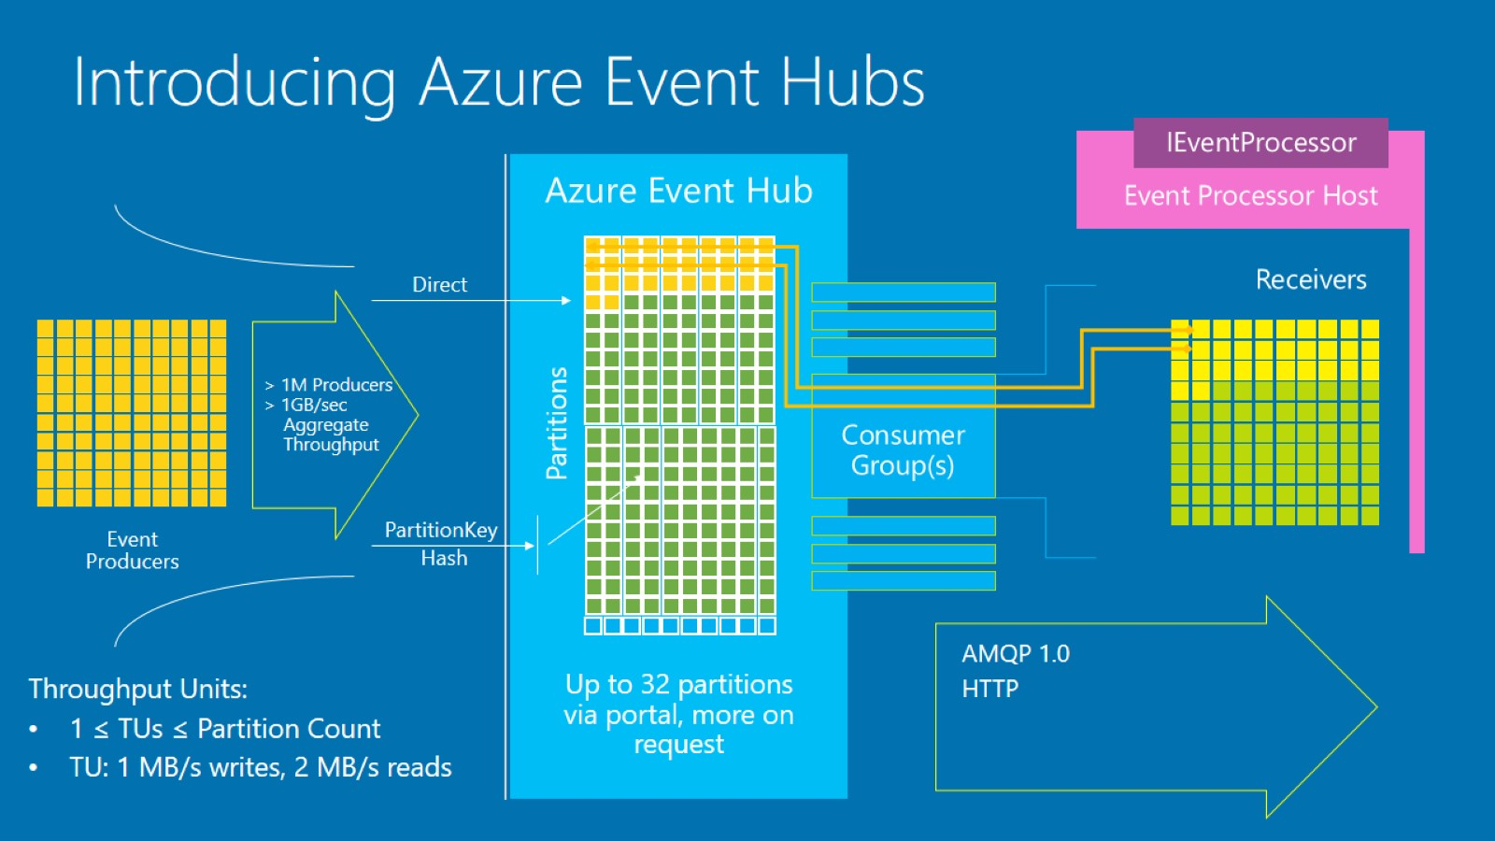
Introducing Azure Event Hubs

Slide 14
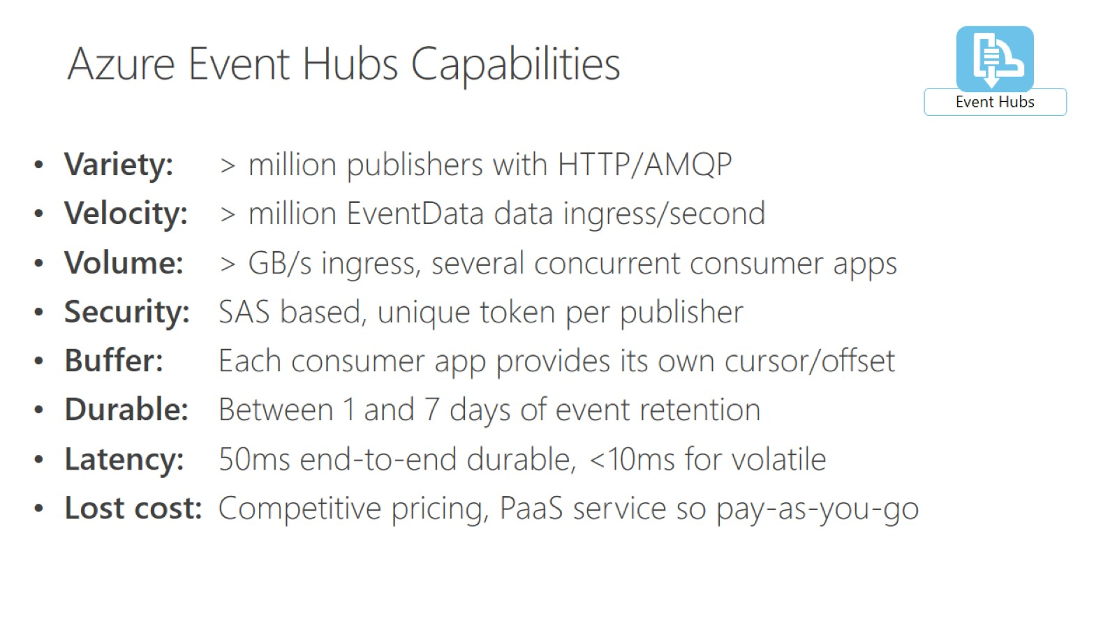

Slide 15
Partitions

Slide 16
Throughput Units

Slide 17
Publishers

Slide 18
Consumer Groups

Slide 19
Consumers

Slide 20
Azure Event Hubs Native Integrations

Slide 22
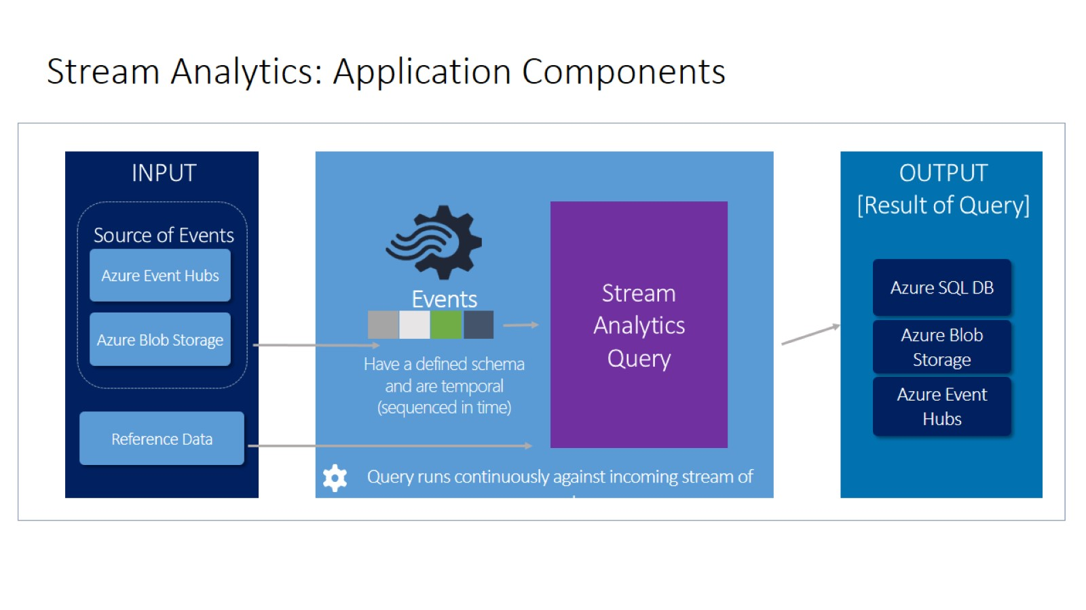
Stream Analytics: Application Components

Slide 23
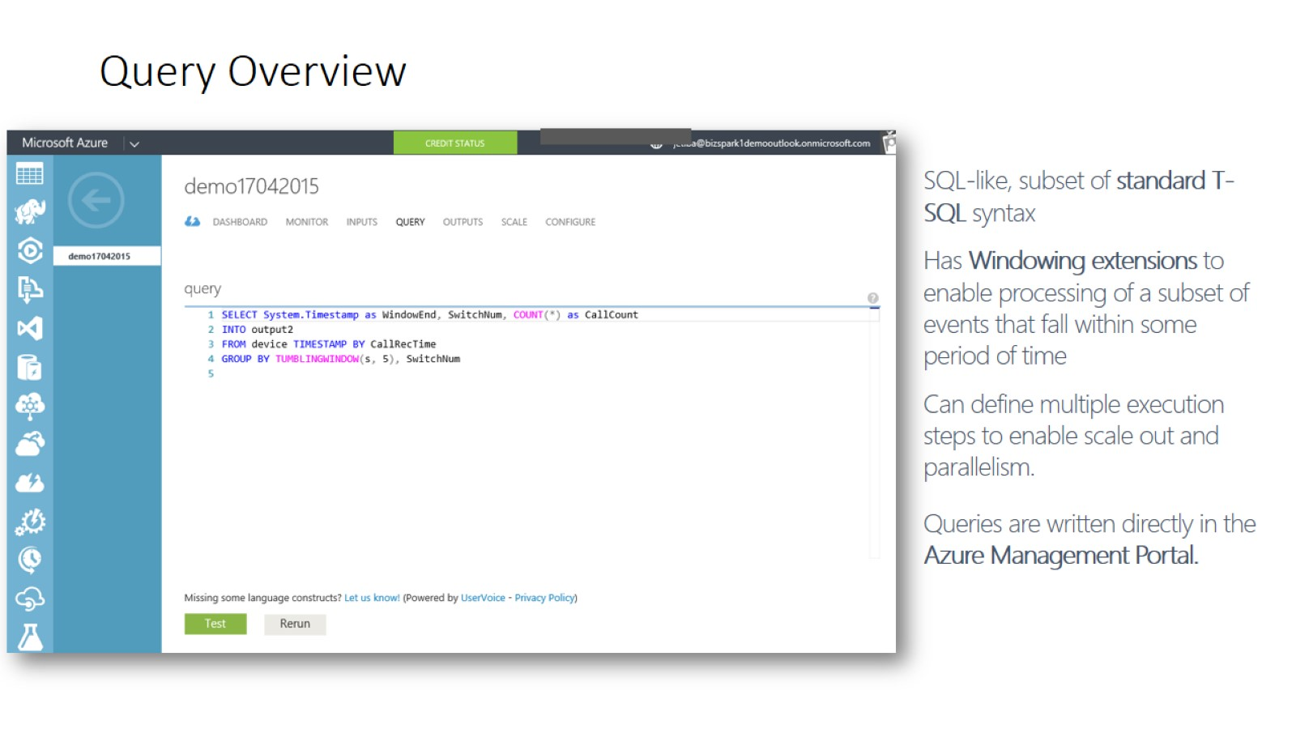
Query Overview

Slide 24
Query Language - Overview

Slide 25
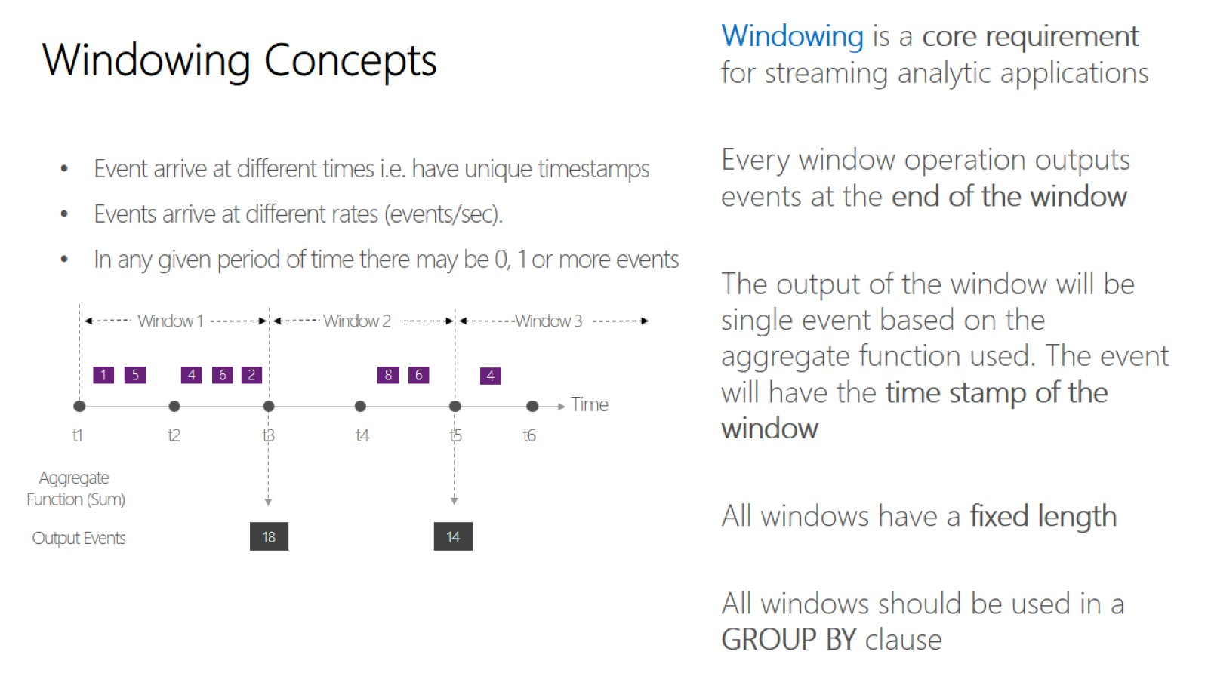
Windowing Concepts

Slide 26
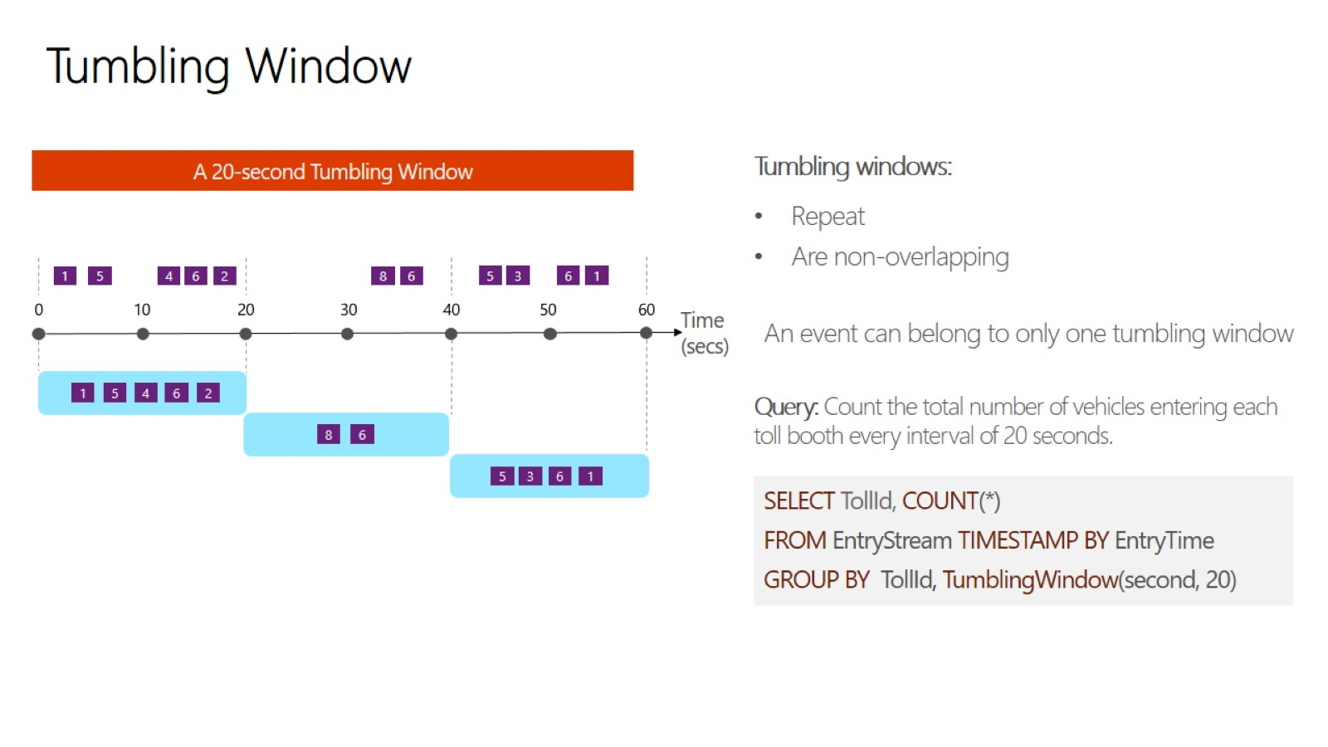
Tumbling Window

Slide 27
PowerBI See all your data in a single pane of glass Live dashboards and interactive reports

Slide 28
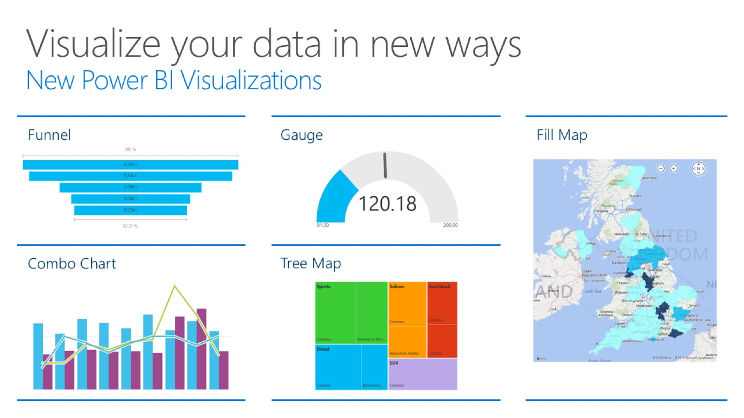
Visualize your data in new ways New Power BI Visualizations

Slide 29
Ask questions of your data Natural Language Query

Slide 32
Why Azure IoT Suite

Slide 33
IoT projects can be complex

Slide 34
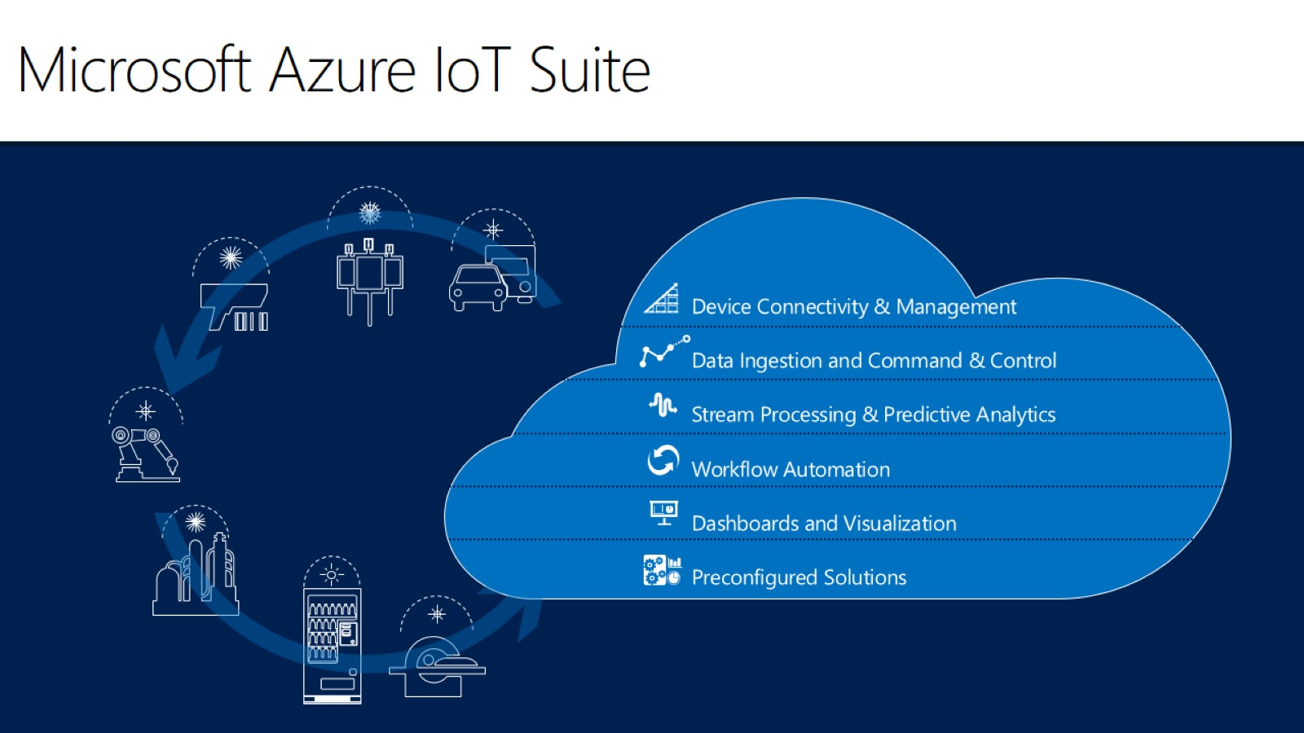
Microsoft Azure IoT Suite

Slide 35
Capture and analyze untapped data to transform your business

Slide 36
Accelerate time to value with preconfigured solutions

Slide 38
What you get with remote monitoring preconfigured solution

